Slide 1

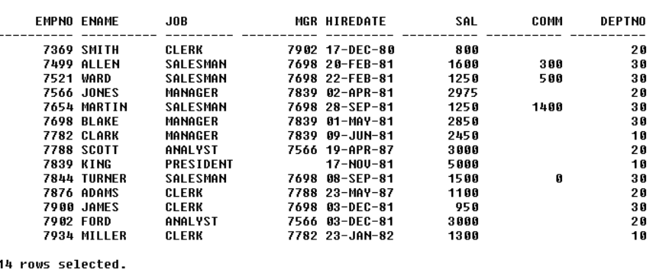
EMPLOYEE TABLE
INPUT:
OUT PUT:

Slide 2
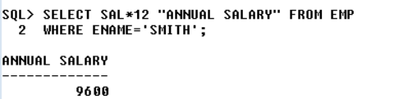
INPUT :
1.WAQTD THEANNUAL SALARY OF THE EMPLOYEE WHOS NAME IS SMITH
OUT PUT:

Slide 3
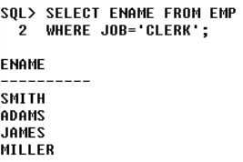
INPUT :
2.WAQTD NAME OF THE EMPLOYEES WORKING AS CLERK.
OUT PUT:

Slide 4
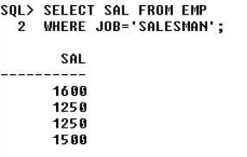
INPUT :
3.WAQTD SALARY OF THE EMPLOYEES WHO ARE WORKING SALESMAN.
OUT PUT:

Slide 5
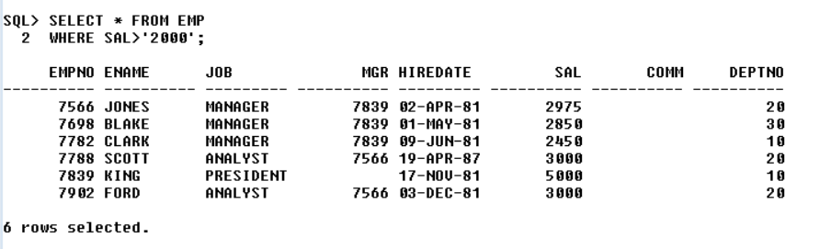
INPUT :
4.WAQTD DETAILS OF THE EMP WHO EARNS MORE THAN 2000.
OUT PUT:

Slide 6
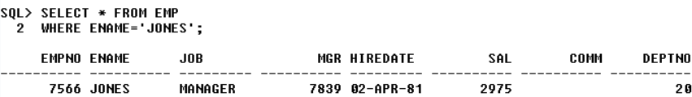
INPUT :
5.WAQTD DETAILS OF THE EMP WHOS NAME IS JONES
OUT PUT:

Slide 7
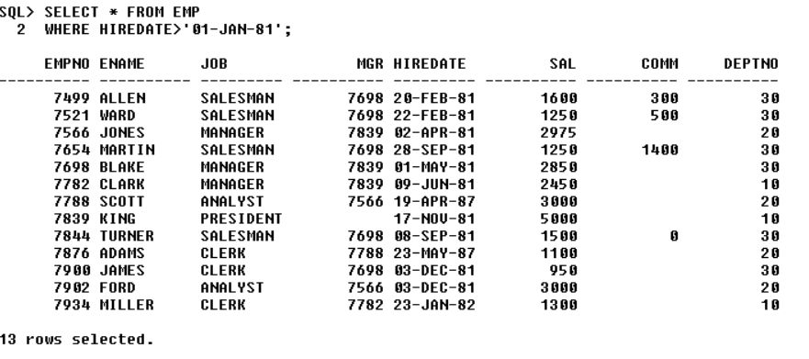
INPUT :
6.WAQTD DETAILS OF THE EMP WHO WAS HIRED AFTER 01-JAN-81 .
OUT PUT:

Slide 8
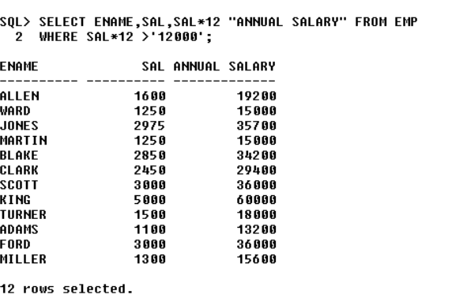
INPUT :
7.WAQTD ENAME AND SAL ALONG WITH HIS ANNUAL SALARY IF THE ANNUAL SALARY IS MORE THAN 1200.
OUT PUT:

Slide 9
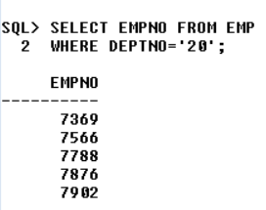
INPUT :
8.WAQTD EMPNO OF THE EMPLOYEES WHO ARE WORKING IN DEPT 20.
OUT PUT

Slide 10
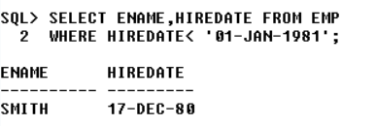
INPUT :
9.WAQTD ENAME AND HIREDATE IF THEY ARE HIRED BEFORE 1981.
OUT PUT:

Slide 11
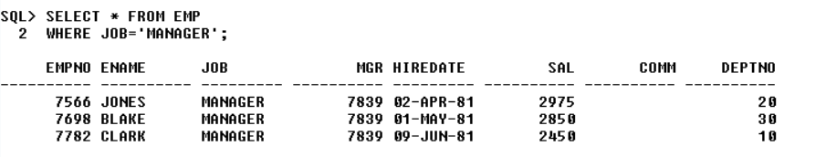
INPUT :
10.WAQTD DETAILS OF THE EMPLOYEES WORKING AS MANAGER.
OUT PUT:

Slide 12
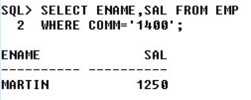
INPUT :
11.WAQTD ENAME AND SALARY GIVEN TO AN EMPLOYEE IF EMPLOYEE EARS A COMMISION OF RS .1400.
OUT PUT:

Slide 13
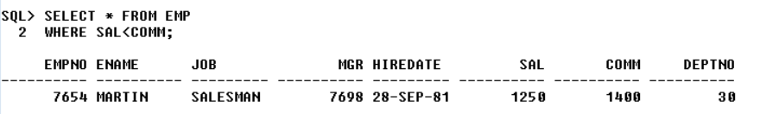
INPUT :
12.WAQTD DETAILSOF EMPLOYEES HAVING COMMISSION MORE THAN SALARY.
OUT PUT:

Slide 14
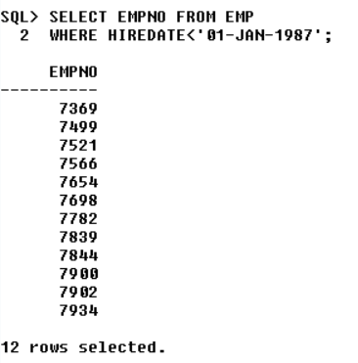
INPUT :
13.WAQTD EMPNO OF EMPLOYEES HIRED BEFORE THE YEAR 87.
OUT PUT:

Slide 15
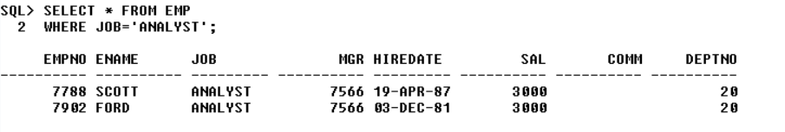
INPUT :
14.WAQTD DETAILS OF EMPLOYEES WORKING AS AN ANALYST.
OUT PUT:

Slide 16
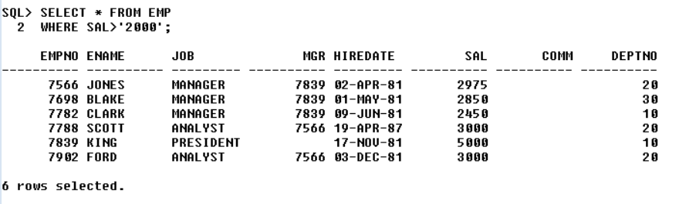
INPUT :
15.WAQTD DETAILS OF EMPLOYEES EARNING MORE THAN 2000 RS.PER MONTH.
OUT PUT:

